Slide 1
Motivation & Emotion
Chapter 12

Slide 2
I Can…
Describe four theories of motivation.
Discuss the difference between intrinsic and extrinsic motivation.

Slide 3
Why do people try to climb Mt. Everest?
Why do they cross the Atlantic in hot air balloons?
Why do some people memorize batting averages?
Why do some do some people give so much more than others seem to?

Slide 4
Motivation
Research on motivation includes the “whys” of behavior.
Motivation: an internal state that activates behavior and directs it toward a goal.
Includes the psychological and physiological factors that we act certain ways at certain times.

Slide 5
Motivation
Motivation cannot be directly observed.
Behavior is energized by motives that may originate inside or outside of us.
Psychologists explain motivation in different ways:
Instinct
Drive-reduction
Incentive
Cognitive theories of motivation

Slide 6
Instinct Theory
1900’s William McDougall proposed humans were motivated by a variety of instincts.
Instinct: natural or inherited tendency to respond to certain stimuli in a certain way without reason.
Occur in all species.
William James proposed we have certain instincts: cleanliness, curiosity, parental love, sociability, sympathy.

Slide 7
Instinct Theory
The flaw with instinct theory is that it describes behaviors, and does not explain why they occur.
Some psychologists still study instinct, now called fixed action patterns, but they are no longer studied along with motivation.

Slide 8
Drive-Reduction Theory
Something that motivates us moves us to action.
The thing that motivates us starts with a need, and leads to a drive.
We have physiological and psychological needs.
Physiological: oxygen, food, water, sleep
Psychological: self-esteem, social approval
Psychological needs do not need to be filled for survival.

Slide 9
Drive-Reduction Theory
A need produces a drive.
A drive is a state of tension produced by a need that motivates an organism toward a goal.
Hunger drives us to eat
Curiosity drives us to discover
Fatigue drives us to rest

Slide 10
Drive-Reduction Theory
Theory comes from the work of Clark Hall
He traced motivation back to physiological needs.
When deprived of something we need or want we become tense and agitated.
To relieve the tension, we engage in an activity to maintain homeostasis, or the tendency to correct imbalances and deviations from our norm.

Slide 11
Drive-Reduction Theory
If the behavior reduces the drive, then the organism will continue to use that behavior to satisfy that drive.
If the behavior continues to work to reduce the drive, then a habit can form.

Slide 12
Drive-Reduction Theory
Hull suggested that all human motives, acceptance, affection, property, etc, all stem from basic biological needs.
People develop extensions of physiological needs through conditioning and generalization.
The need for approval becomes important in itself, so approval is a learned drive. Not all drives are natural.

Slide 13
Drive-Reduction Theory
The results of some experiments show that Hull may have overlooked some important factors.
According to drive-reduction theory, infants become attached to their mothers because their mothers relieve drives such as hunger and thirst.
Harry Harlow, and others, doubted this was true.

Slide 14
Drive-Reduction Theory
Harlow took baby monkeys away from their mothers and put them in a cage with 2 substitute mothers made of mostly wire.
One of the wire moms had the sole bottle in the experiment, while the other was covered with soft cloth.
The baby monkeys preferred the cloth mother, even though the other mother provided all the food.

Slide 15
Drive-Reduction Theory
Some theorists overlooked that fact that some experiences are inherently pleasurable.
Soft animals, cuddling a buddy, sometimes hugging…
Although they do not reduce drives, they serve as incentives or goals for behavior.

Slide 16
Drive-Reduction Theory
Sometimes we participate in activities that increase our tension.
Roller coasters
Scary movies
Many psychologists conclude there can be no general theory of motivation, as Hall suggested.
There are many behaviors that cannot be explained through deprivation.

Slide 17
Incentive Theory
Incentive theory emphasizes the role of the environment in affecting behavior.
An incentive is the external reward or reinforcer that motivates a behavior.
Incentives are also known as goals, rewards, and achievements.
Incentives pull us to obtain our needs.

Slide 18
Incentive Theory
For example, hunger may cause us to walk to the cafeteria, but the sandwich is the incentive.
Depending on how strong the drive is, we may not care how weak the incentive is. (bland sandwich)
If the drive is weak, we may still eat, because the incentive is strong… our favorite sandwich.
We are motivated to obtain incentives.

Slide 19
Cognitive Theory
Cognitive psychologists look at forces both inside and outside of us that create our drives.
They believe we act for either intrinsic or extrinsic motivations.
Extrinsic motivation engages us in activities that either reduce biological needs or help us obtain external incentives.
Intrinsic motivation comes from within. We do something because it is rewarding to us personally, or fulfills our beliefs or expectations.

Slide 20
Cognitive Theory
For example, if you spend hours practicing basketball because you want to excel at the sport, that is an intrinsic motivator.
If you practice because your parents want you to excel, that is an extrinsic.
If you play just for the fun of playing, it is intrinsic.

Slide 21
Cognitive Theory
Many times your motivation is both intrinsic and extrinsic.
Many psychologists believe in the overjustification effect.
When people are given a too much extrinsic motivation to complete a task, their intrinsic motivation declines.
Ex. You like to read, if someone started to pay you, you may enjoy reading less. You may ask yourself “why am I doing this? Its not to enjoy books, its for the money” And read less.

Slide 22
I Can…
Describe the biological and social needs of humans.
Explain Maslow’s hierarchy of needs.

Slide 23
Biological and Social Motives
People spend much of their lives trying to satisfy both biological and social needs.
Ex. Eating. We eat for biological and social reasons.
But why are some people motivated more than others to achieve success?

Slide 24
Biological motives
Some behavior is determined by the internal, or physiological state of the organism.
Biological needs are critical to survival and physical well-being.
The nervous system is designed to change behavior to return a body to a condition of chemical balance when there are variations in some chemicals.

Slide 25
Biological motives
All humans have built-in regulating systems to control things like temp., blood sugar, and hormones.
The tendency of the body to correct imbalances and deviations from normal is called homeostasis.

Slide 26
Biological motives
Hunger is one of the drives that is homeostatic.
Sometimes you eat because you are in a habit of having lunch at a certain time, or because you are being sociable, or maybe because you are tempted by the sight or smell of a certain food.
Other times you may eat because you have an aching sensation in your stomach, and you haven’t eaten for hours.

Slide 27
Biological motives
Your body requires food to repair itself and to store reserves of energy.
If the lateral hypothalamus(LH) is stimulated, it provides signals for you to eat.
If the ventromedial hypothalamus(VMH) is stimulated you will slow down or stop eating all together.
These signals are also more responsive in certain temperatures. LH responds more in cold temps, while the VMH responds more in warmer temperatures.

Slide 28
Biological motives
Other factors also influence your hunger.
Blood sugar levels
Weight set-point
Your day-to-day weight fluctuation point

Slide 29
Biological motives
Other hunger factors that may cause you to feel hungry or eat.
These factors are called psychosocial hunger factors
Smell and appearance of food
If other people are eating
Social pressures
Boredom or stress
Time of day
Situation

Slide 30
Biological motives
There is growing evidence that biology affects a person’s weight.
Obesity is considered 30% over ideal body weight, while overweight is 20% over.
Currently about 1/3 of Americans are obese.

Slide 31
Biological motives
Studies show that obese people tend to eat by responding to external cues instead of internal cues, like hunger.
Overweight people are more likely to eat because food is available than people of normal weight.
Other factors like exercise also contribute to obesity.
It has shown though, that anxiety and depression do not.

Slide 32
Social motives
Social motives are learned from other people.
The achievement motive is one example.
Why do some people desire to set goals and persist in reaching them despite obstacles and frustrations?
Achievement motive has been studied in depth by David McClelland.

Slide 33
Social Motives
The TAT is a series of pictures that the participant is instructed to make up a story about what is occurring in each picture.
There are no right or wrong answers because the answers are created from the participants beliefs, motives, and attitudes.
Each story is “coded” for themes and the themes are scored according to their relevance to certain themes, such as setting goals, competing, and overcoming obstacles.

Slide 34
Social Motives
Participants score a high need for achievement if they display persistence on tasks, or the ability to perform better on tasks, set challenging goals, compete to win, and are attracted to challenging tasks or careers.

Slide 35
Social Motives
McClelland followed students at Wesleyan University and found that 83% of students in entrepreneurial work were high scorers in achievement, while only 21% of the nonentrepreneurial students were had scored highly in achievement.
Studies show that high achievers prefer to be associated with people who will help them to achieve as opposed to more friendly people.
They may be less likely to be artistically sensitive, value intimacy in a relationship, or be the most interesting people.

Slide 36
Social Motives
Critics claim that the TAT is not a reliable way of testing achievement because stories are difficult to score due to people’s thoughts and feelings being hard to analyze objectively.

Slide 37
Social Motives
Some people may be motivated from a fear of failure.
People who fear failure may give up on music lessons or trying out for a sports team if they do not feel they will be successful.
People display fear of failure when they purposefully choose tasks that are unchallenging and unlikely to be difficult.
For example, if given a choice of 3 tasks, easy, difficult yet manageable, and extremely difficult, most people choose the midrange difficulty. People afraid of failing will choose the easy task.

Slide 38
Social Motives
People who are motivated by fear of failure often find excuses to explain their poor performances.
They do this to save their self-image.
Examples:
1. slow in a running race due to sleeping poorly
2. poor grade on the test due to a biased test
3. couldn’t fill out their weather sheet because they were sick
Although these excuses help you maintain good feelings about yourself, it prevents you from taking responsibility for your own actions.

Slide 39
Social Motives
Matina Horner identified the side of achievement motivation called motive to avoid success.
People who have a very real chance of being successful in some careers may fear success and choose to avoid it.
Studies show that people who are average or slightly above are usually less fearful.
Expecting success can at times make people more likely to avoid it, despite obvious advantages to being successful.

Slide 40
Social Motives
Problems arose with Horner’s findings when others began studying avoidance of success.
It is difficult to define success
It is difficult to tell whether a person is more afraid of success or failure.
Fear of success, does show up almost equally in men and women.

Slide 41
Social Motives
Other theories
Expectancy – value : expectancy is your likelihood of success and value is what it is worth to you.
Competency theory : if we choose too easy or difficult tasks we learn nothing, so we choose moderately difficult tasks, where failure and success are possible.

Slide 42
Maslow’s Hierarchy of Needs
Abraham Maslow, a pioneer of humanistic psychology, believed that all humans need to feel competent, to win approval and recognition and feel that they have achieved something.
He felt there were needs that we all needed to fulfill, he placed them in a hierarchy, and stated that once we fulfill the most basic needs we move up to the next level.
Maslow believed that humans move up and down the hierarchy based on what they need at the time.

Slide 43
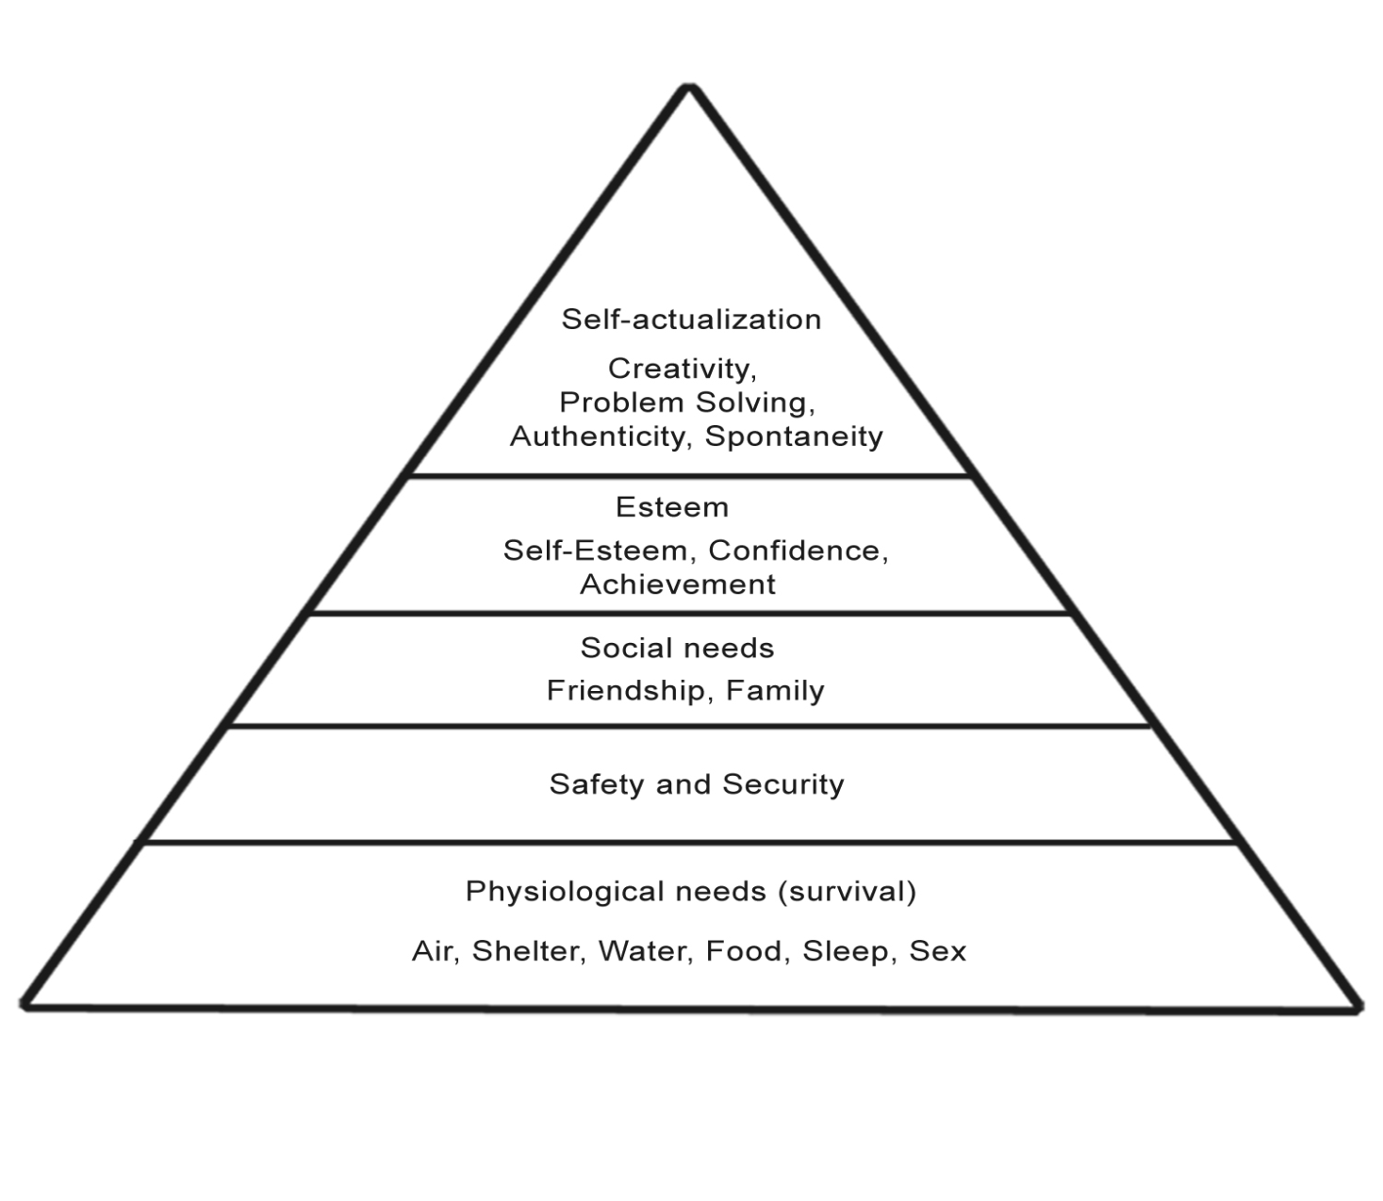
Maslow’s Hierarchy of Needs

Slide 44
Maslow’s Hierarchy of Needs
Maslow’s scheme includes everything we have talked about so far.
He starts with biological needs, or fundamental needs. Maslow thought that you cannot function without these needs being met.
The second level is psychological needs, the urge to belong and give and receive love, and the urge to acquire esteem. These can only be filled by an outside source, and a lack of them may result in random, desperate, maladaptive activities to ease tension.

Slide 45
Maslow’s Hierarchy of Needs
The last level is self-actualization needs.
Self – actualization includes the pursuit of knowledge and beauty and whatever else is required for someone to realize their unique potential.
Maslow did not believe that many people reach this level in the hierarchy.
To reach this level all fundamental and psychological needs must first be met.

Slide 46
Maslow’s Hierarchy of Needs
Other research does not support Maslow’s.
For example, Christopher Columbus risked safety to sail to China, but may have achieved self-actualization.
Some people do not seem interested in fulfilling higher needs such as achievement.
Researchers suggest that Maslow identified all needs people need to meet, but perhaps there is not an order they must be met.

Slide 47
Emotion
No one can make you feel inferior without your consent
~ Eleanor Roosevelt

Slide 48
Emotion
I can give examples of the physiological theories of emotion.
I can explain cognitive theorists’ approach to the study of emotions.

Slide 49
Emotion
Motives and emotions are intertwined.
One describes the source of our behavior, while one describes the feelings associated with the behavior.
Often we use our emotions to explain our motives.
Emotions cause us to:
Make decisions and communicate
Give us incentive
Energize us to pursue goals

Slide 50
Emotion
Emotional intelligence : is the ability to percieve, imagine and understand emotions and use that information in decision making.
It helps us to gauge situations and determine appropriate actions.
Testing emotional intelligence

Slide 51
Emotion
Emotion is defined as a set of complex reactions to stimuli involving subjective feelings, physiological arousal, and observable behavior
Emotions result from 4 occurrences:
Interpret a stimulus
You have a subjective feeling
You experience physiological responses
You display an observable behavior
Emotions have 3 parts:
Physical
Behavioral
cognitive

Slide 52
Emotion
The physical aspect of emotion has to do with how the emotion affects the physical arousal of an individual.
The behavioral aspect is the outward expression of the body, such as body language, hand gestures, tone of voice, etc.
The cognitive aspect is the way we interpret a situation.

Slide 53
Emotion
Basic facial expressions are innate, that is a biologically inherited trait.
All humans recognize the same facial expressions for anger, surprise, happiness, and sadness.
Even children who were born without sight and hearing support this when they laugh when happy, pout and frown when upset, and clench teeth and fists when angry.

Slide 54
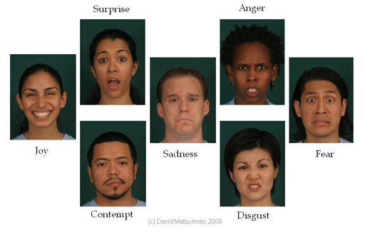
Emotion
Carroll Izard and colleagues have identified 10 different emotional states in humans using eyebrows, eyes and mouth.
These are universally recognized expressions.

Slide 55
Emotion
James Averill believes that many of our everyday emotional reactions are the result of social expectations and consequences.
Children are taught what emotions are appropriate from their parents, by how parents respond to the child.
Children learn which emotions are appropriate in certain situations and to express them at the appropriate times.
All of us are born with the ability to express emotions, but we learn when, where and how to express them.

Slide 56
Emotion
There are several theories of emotions
James – Lange theory – bodily changes form the basis of labeling and experiencing emotions. Information for emotions comes from signals from our bodies.
Cannon – Bard theory – experiences activate the thalamus and the thalamus sends messages to the cortex and body organs. (Later it was shown that the thalamus is not involved.)

Slide 57
Emotion
Cognitive theories – belive that the bodily changes and thinking work together to produce emotions.
Schachter – Singer Experiment – participants were told they were being tested for vitamin C and it’s effect on eyesight. In truth, most participants were given an adrenalin injection.
There were accomplices to sit and wait with the participants.
Some acted wild and crazy
Some became angry as they filled out an offensive questionnaire.
The participants who had been told to expect side effects, or who had incorrect ideas about what would happen usually joined in with the accomplices.

Slide 58
Emotion
This experiment demonstrated that internal components of emotion, such as adrenaline, affect a person differently depending on their interpretation or perception of the situation.
People take cues from their environment.
Perception and arousal interact to create emotions.

Slide 59
Emotion
Opponent – Process Theory
Remember the body has the sympathetic and the parasympathetic nervous systems.
The sympathetic energizes the body for activity
The parasympathetic calms and relaxes the body.
The opponent – process theory states that these two systems act to regulate and manipulate our emotions.
The external event is state A and the internal force is state B

Slide 60
Emotion
So, imagine you meet someone that you really get along with. They are the bread to your butter.
You find out they are moving away the next week.
How upset are you? Likely not too upset. You were subject to state A, but no state B.
What about if your spouse of 50 years dies?
What about when your parents or a sibling dies?

Slide 61
Emotion
Essentially, this theory states that when the stimulus for one emotion is removed, you feel the opposite emotion.
If state A is a terrifying event, it predicts what state B will be – elation when you reach the ground.

Slide 62
Emotion
Emotion researchers agree that emotions play an important role in our survival and ability to achieve goals.
Emotion encourages us to act.
And they agree that emotions and physical changes are connected.

